Slide 1
WNM 617 Mobile Web Tech
Responsive Web Design

Slide 2
Responsive Web Design
Responsive Web design is the approach that suggests that design and implementation of a website should respond to the user’s behavior and environment based on screen size, platform and orientation of the device.

Slide 3
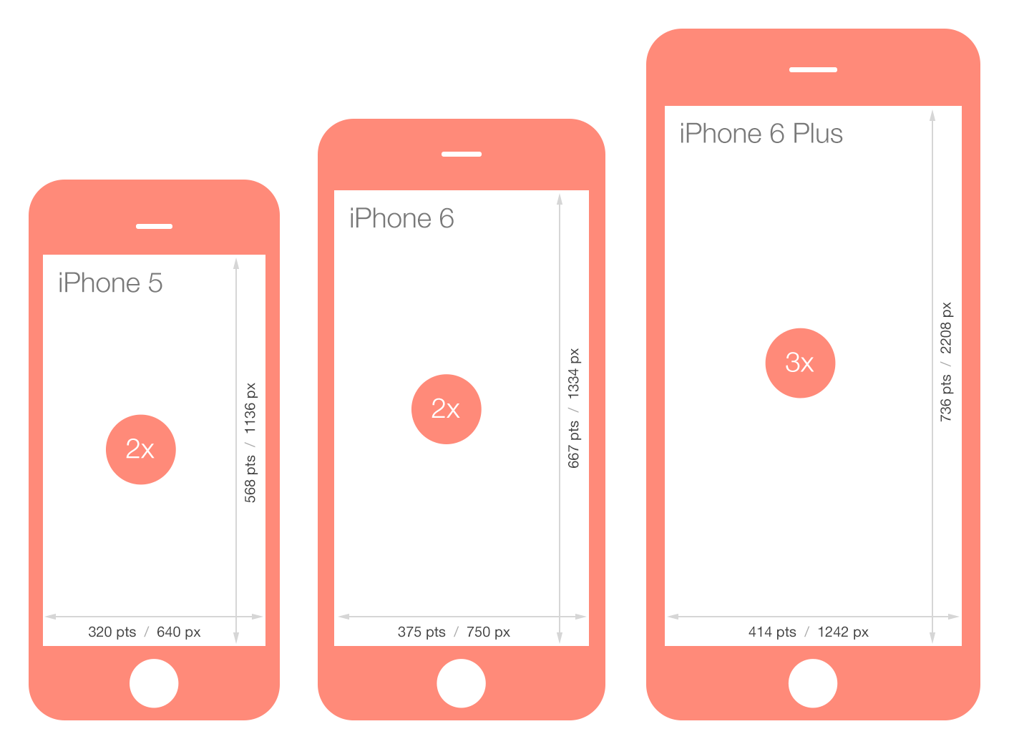
Screen Sizes - iPhone

Slide 4
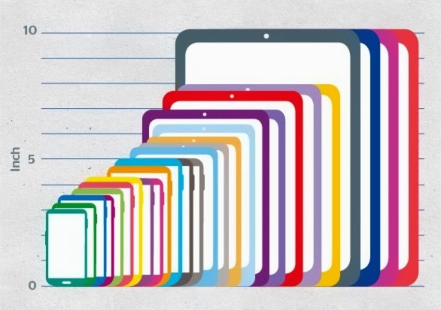
Screen Sizes - Android

Slide 5
Screen Sizes – Other Devices
Kiosks
Feature Phones
HUGE screens

Slide 6
Mobile Websites
In the previous years websites consisted of two versions (we don’t do this anymore)
Typical Desktop site on a typical domain (www.facebook.com)
A mobile website designed strictly for a mobile device placed under a subdomain (m.facebook.com)

Slide 7
The Flexible Foundation
Fluid Layout and Fluid Images

Slide 8
Flexible Design
Flexible Design is only one part of Responsive Web Design. It is important that we create our responsive sites with fluid layouts and images. They are the base to build our responsive design from

Slide 9
Fluid Layout
We should use fluid layouts to handle different resolutions. Don’t use fixed layouts
DEMO

Slide 10
What about the Grid!?!
Grids are just ways we can layout our sites in a organized manner. Grid layouts can be Fluid/Responsive or not. Most grid frameworks are responsive.

Slide 11
Fluid Images
We can’t forget to make our images fluid. They need to change size based on the browser size. Luckily there is an easy way to achieve this in CSS
max-width: 100%

Slide 12
The Responsive Part
Media Queries and Viewports

Slide 13
So What is Responsive Design?
Fluid Layout (Grids) + Fluid Images + Media Queries

Slide 14
Media Queries
Media Queries allow us to target our CSS styling and layout to specific device characteristics through media types
Screen size (the one we care about)
Print
Speech
Media Queries have a number of different “Features” that we can use
max-device-width
orientation
Etc…
*Note: We really only care about max-device-width

Slide 15
CSS Syntax for Media Query
Example Media Query
@media screen and (max-device-width = 375px){
#our CSS for a device up to this size
}

Slide 16
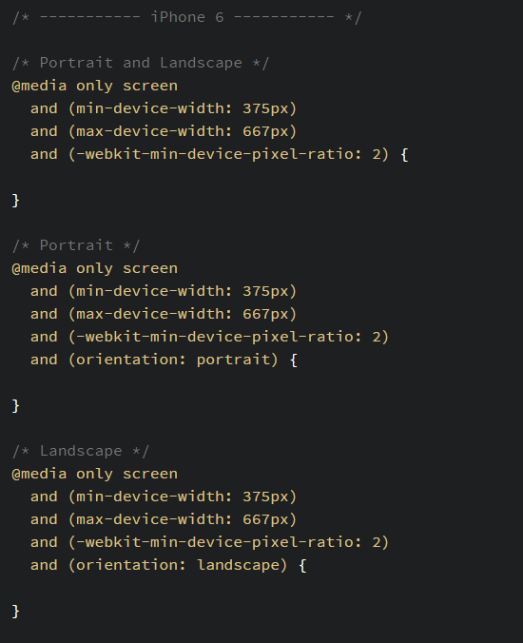
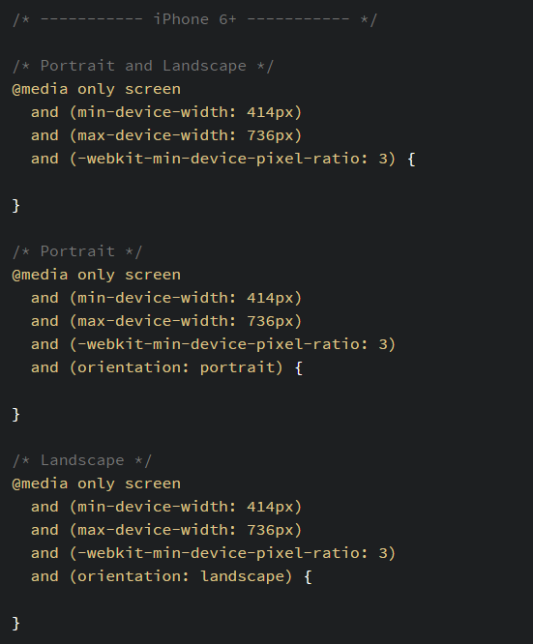

Slide 17
Standard Device Media Queries
https://css-tricks.com/snippets/css/media-queries-for-standard-devices/

Slide 18
Demo

Slide 19
Viewport
The viewport is the users visible area of the web page
Viewports will vary based on device size. So they get smaller with the device
If we do not set the viewport in our HTML our webpages will look fine on a desktop browser but will scale down on a smaller device browsers

Slide 20

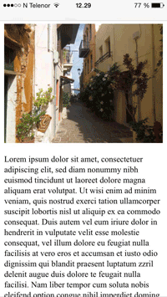
To Viewport or Not to Viewport
Viewport Not Set
Viewport Set

Slide 21
Setting the Viewport
We set the viewport in the head of our HTML document with a meta tag
The attribute content-width is set to “device-width”
The attribute scale is set to 1 for a 1 to 1 scale. You can set it to other values but 1 is standard
Ex. <meta name="viewport" content="width=device-width, initial-scale=1.0">

Slide 22
Demo

Slide 23
Initializr
A Simple Responsive Template

Slide 24
Initializr
Initializr is a simple to use responsive web template
http://www.initializr.com/
For our walkthrough purposes we will use the Responsive Version

